Slide 1
Computer Science and Problem Solving
CPSC 231:
Intro to Computer Science for
Computer Science Majors I
Fall 2023

Slide 2
Computer Science is Problem Solving
But what is problem solving?
Notes:
So problem solving is a fundamental cognitive process used to address and resolve challenges or questions encountered in various situations.
It involves systematic approach to finding solutions to problems by identifying, analyzing, and evaluating options.
- understanding the problem
- breaking down the problem: complex problems are broken down into smaller and more manageable sub problems.
- generating solutions
- analyzing and evaluating the solutions
- selecting best solutions
- implementing the solution by writing code, designing system, etc.
- testing and validation
- iterating and refining
- documentation

Slide 3
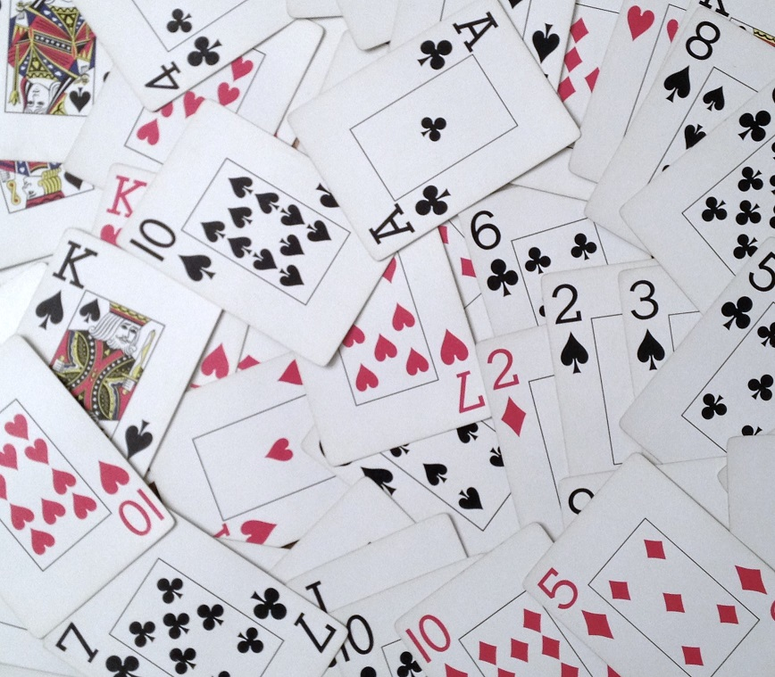
Question for class
I have a deck of cards, shuffled
I ask you to sort the deck. How do you start?
This Photo by Unknown Author is licensed under CC BY-SA-NC
Notes:
We can start in different ways:
Random Selection: Randomly select a card from the shuffled deck as a starting point. Then we can draw card at a time and decide where it should go to sort the cards.
Divide and conquer: We can divide the cards in smaller groups, sort those smaller groups, and combine them to make the final solution.
Initial Setup: Begin with the shuffled deck of cards, which is unsorted.
Iterate Through the Deck: Start with the first card (the leftmost card) and compare it to the card immediately to its right. If the left card is larger than the right card, swap them.
Repeat: Continue this process, moving from left to right through the entire deck, comparing adjacent cards and swapping them if necessary. After this first pass, the largest card will have "bubbled up" to the rightmost position in the deck.
Repeat the Process: Repeat the process (step 2 and 3) for the remaining cards in the deck (excluding the rightmost card, which is already in its correct position). In each pass, the next largest card will bubble up to its correct position, which is one position from the right end of the deck.
Continue Iterating: Continue iterating through the deck, repeating the comparison and swapping process until no more swaps are needed in a pass. This indicates that the deck is sorted.
Final Result: Once the deck is sorted (i.e., no swaps are needed in a pass), you have successfully ordered the cards from lowest to highest.

Slide 4

https://www.youtube.com/watch?v=xli_FI7CuzA&ab_channel=MichaelSambol

Slide 5
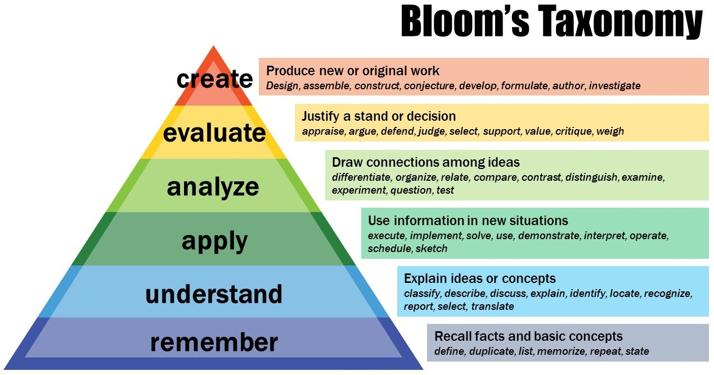
What does it mean to learn something?
This Photo is licensed under CC BY-NC
Notes:
When it comes to learning something, we refer to bloom’s taxonomy which categorizes learning into a hierarchy of six levels. Each level here represents different stage of cognitive development and understanding. Starting from the bottom:
Remember: it involves the ability of recall facts, information, or concepts. Here, learners can remember and recognize previously learned materials.
Understand: Here the learner extracts the meaning of information. They can interpret, explain, and summarize concepts in their own words.
Apply: In this stage, learners can use their knowledge and understanding to solve problems or apply concepts in new situations. It basically focuses on practical application and implementation.
Analyze: In this level, learners can break down complex information into its components, identify patterns, relations, and connections between different elements.
Evaluate: In evaluate stage, learners assess the quality or effectiveness of ideas or the solutions. They can make judgements and form opinions based on evidence.
Create: This is the highest level where the learners generate new ideas or produce original work. This involves designing, development or formulating innovative solutions.

Slide 6
Solving Problems
How do we solve problems?
Break original problem into smaller, more easily solvable parts and repeat on the smaller sub-problems.
Similar process used in expository writing (break topic up into easily-understandable bits, express in coherent way).

Slide 7
Top Down Design
Start with the entire problem
01
Break the problem into approximately 3 to 5 smaller steps
02
Repeat the process for each step that is still too complex
03
Notes:
Start with the Entire Problem: Begin by understanding the complete problem statement or task at hand. This involves grasping the overall objective and the scope of what needs to be accomplished. It's essential to have a clear understanding of what you're trying to achieve.
Break the Problem into Approximately 3 to 5 Smaller Steps: Once you have a grasp of the entire problem, identify 3 to 5 key sub-steps or components that can be logically separated from the main problem. These sub-steps should represent significant aspects of the problem and serve as a structured way to approach the problem's solution.
Repeat the Process for Each Step That Is Still Too Complex: For each of the 3 to 5 sub-steps you identified, apply the same problem-solving process. If any of these sub-steps are still complex or involve multiple tasks, you can further break them down into smaller, more manageable steps until you have a set of tasks that are straightforward to address.

Slide 8
Problem Solving with Coding
Very similar process
Examine the entire problem first
Break down problem into smaller steps
Break down each step if still too complex
Write code to solve each step (coding happens at the end!)
Notes:
Lets assume, we want to write a program to solve the equation: x = 2+3-1
Step 1: Identify the Operations
So, by examining the problem, we can understand that we need to solve an equation that have 2 operations (sum, and subtract)
Step 2: Break Down the Equation
Break down the equation into smaller sub-equations, each focusing on one operation at a time. Start with the leftmost operation and move towards the right.
Sub-Problem 1: Solve for the sum of 2 + 3.
Sub-Problem 2: Subtract 1 from the result obtained in Sub-Problem 1.
Step 3: Solve Each Sub-Problem
Solve each sub-problem individually.
Sub-Problem 1: 2+3=5
Sub-Problem 2: 5−1=4
Step 4: Combine the Sub-Problem Solutions
Combine the solutions from the sub-problems to find the final solution for the original equation.
The solution is x = 4.
By breaking down the equation into smaller sub-problems, you can systematically solve each part of the calculation, making it easier to arrive at the final answer.

Slide 9
Bonus
Answer the question posted in top hat.
Go to this link: https://app-ca.tophat.com/login
Or Join by using the code: 066729.
Use ucalgary email address, UCID, and your full name in the account.
You will have 90 seconds to submit your answer.

Slide 10
Credits
Content created and adapted for CPSC 231 by Jonathan Hudson and Richard Zhao.

